Slide 1

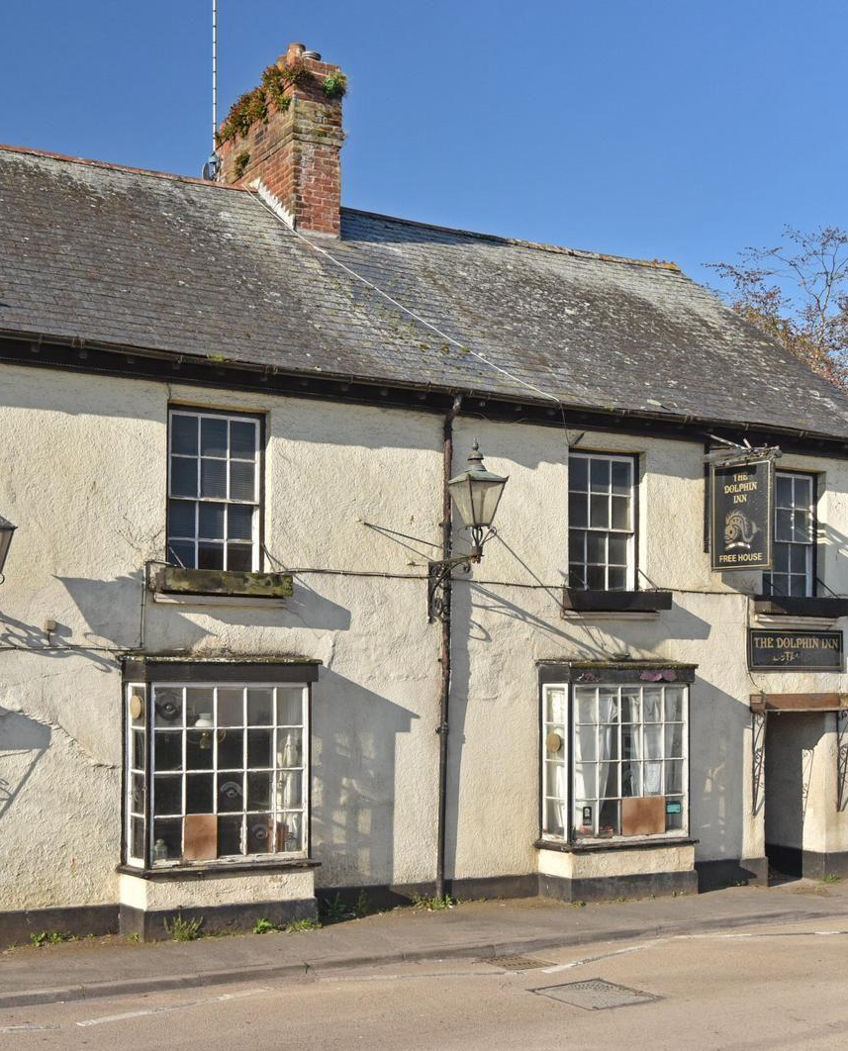
WE NEED YOU!
At THE DOLPHIN INN
‘The Heart of our Village’

Slide 2
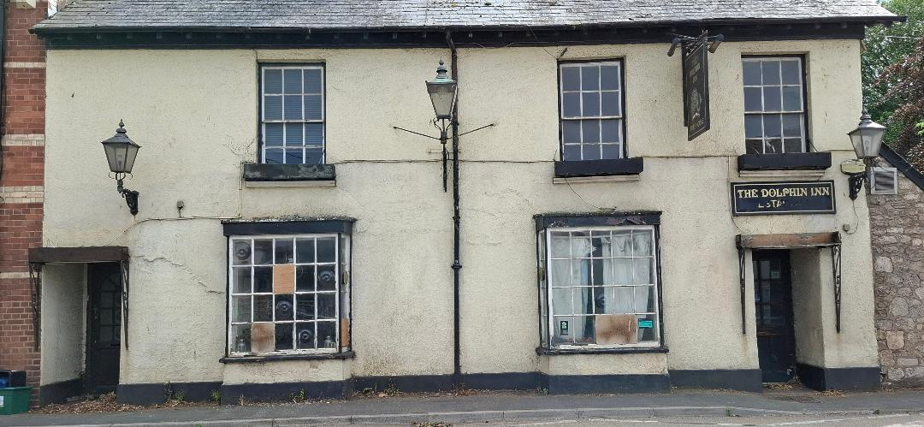
We want to go from…

Slide 3
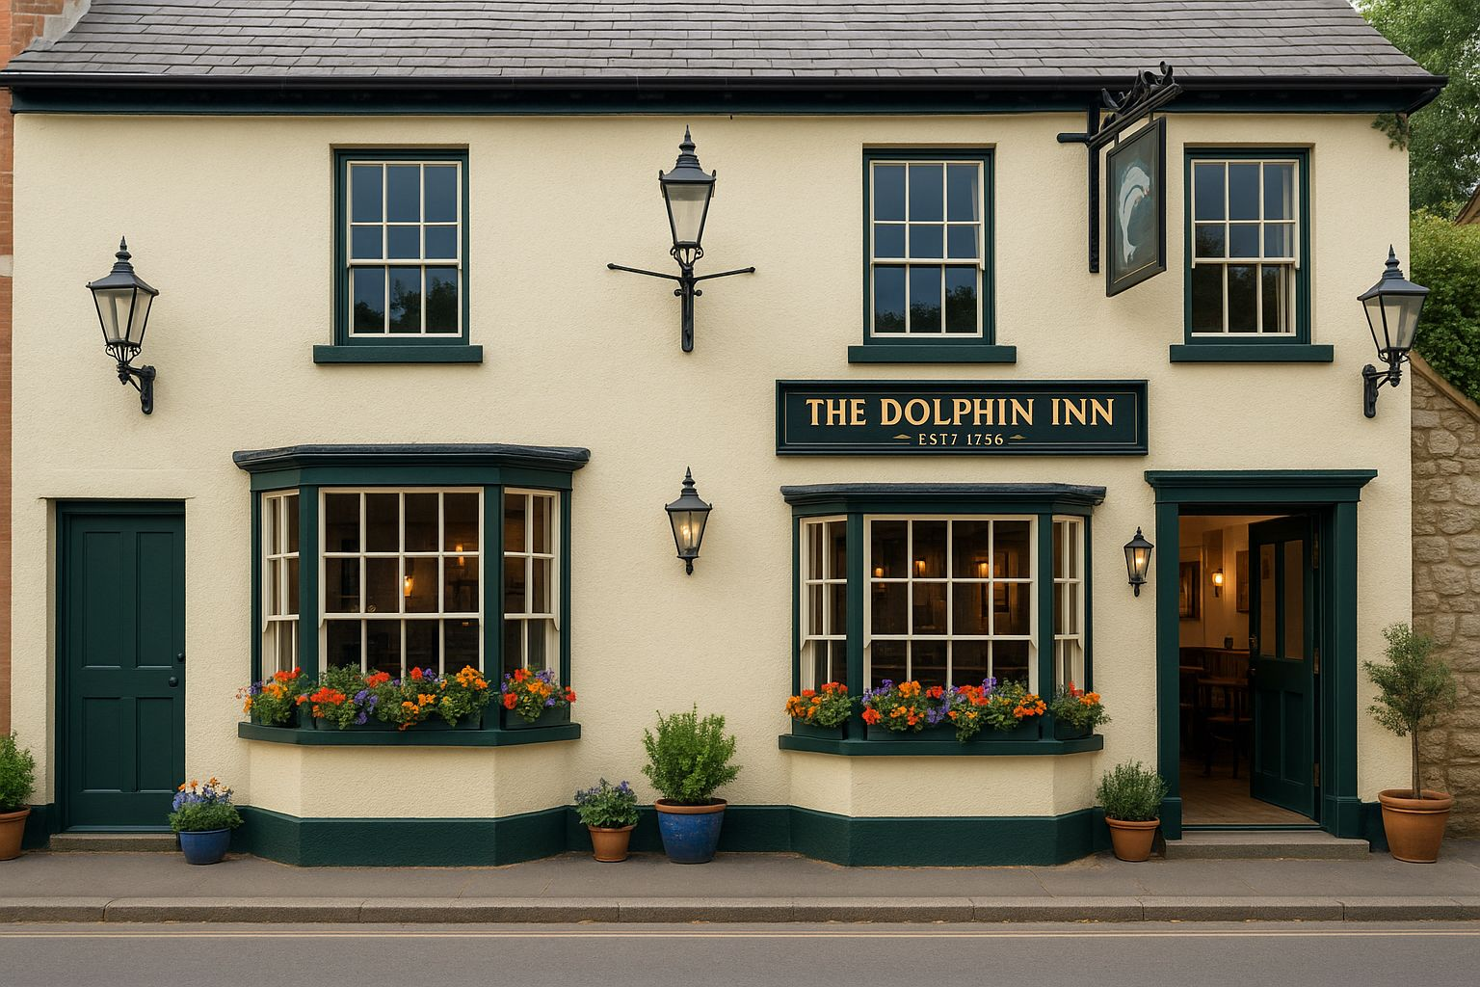
TO THIS!

Slide 4
Why are we having this meeting?
To share the current objectives
To share where we are now
To share what else we need to deliver the current objective

Slide 5
Formed a Committee of 10 members and 4 volunteers.
WHAT HAVE WE DONE TO DATE?
Chair: Jon Hare
Vice Chair: Dave Everson
Secretary: Denise McMurray
Treasurer: Jayne Archer
Notes:
Comply with Plunkett Rules, this enabled us to register this committee as ‘The Dolphin Inn, Kenton Ltd’ with the FCA.
Previous committee – paperwork – registration with FCA and change of address with companies house.
We cannot take any funds or invite shares until this had been registered correctly.

Slide 6
Andrew Bryant
Dan
Robin and Georgie
Sue
Jane C
Ros and Callum
David Blount
Thank you to the Committee members and volunteers:
Notes:
ANDREW: with great experience and a lot of time produced the Business plan and Share offer document.
DAN: Helped with Andrew and superb Carpentry and together with those legs – cycling to deliver the far outer edges of Kenton leaflet drop.
ROBIN AND GEORGIE: Superb work on Facebook, Go Fund Me pages.
SUE: For her GDPR excellence, for her amazing spread this evening
ROS AND CALLUM Superb work on our web and graphics and Karaoke line ups!.
JANE C – Ill come back to Jane!
DAVID BLOUNT: For his help in the early stages, his generosity to our committee.

Slide 7
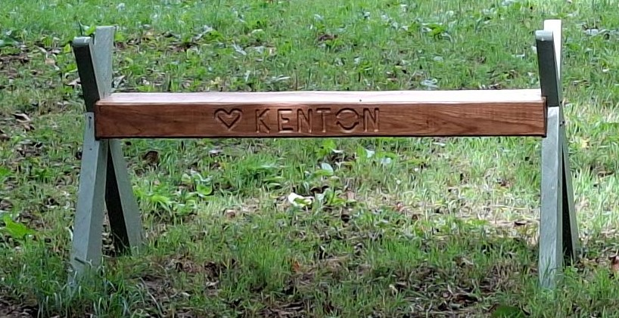
Dan’s Expertise!

Slide 8
Thank you
Matt – for this professional support and amazing ideas for the building.
Roger - purely for his useful comments, and for keeping us under control!
LEGO DOLPHIN UPDATE
We are still lacking some outside walls, windows BUT we do have a bar, seats, tables – and
The Men’s toilets are still outside!

Slide 9
Our community fund raising events
These have been held to raise funds for items such as the building survey, solicitor’s fees and other expenses.
Thank you to those who have offered to help.
Jane C
Notes:
Jane - a committee member who, along with Denise Jane as organised all of the community fund raising. Again, hours of work has gone into this. But in the region of £6000 has been raised within the few events that we have had.

Slide 10
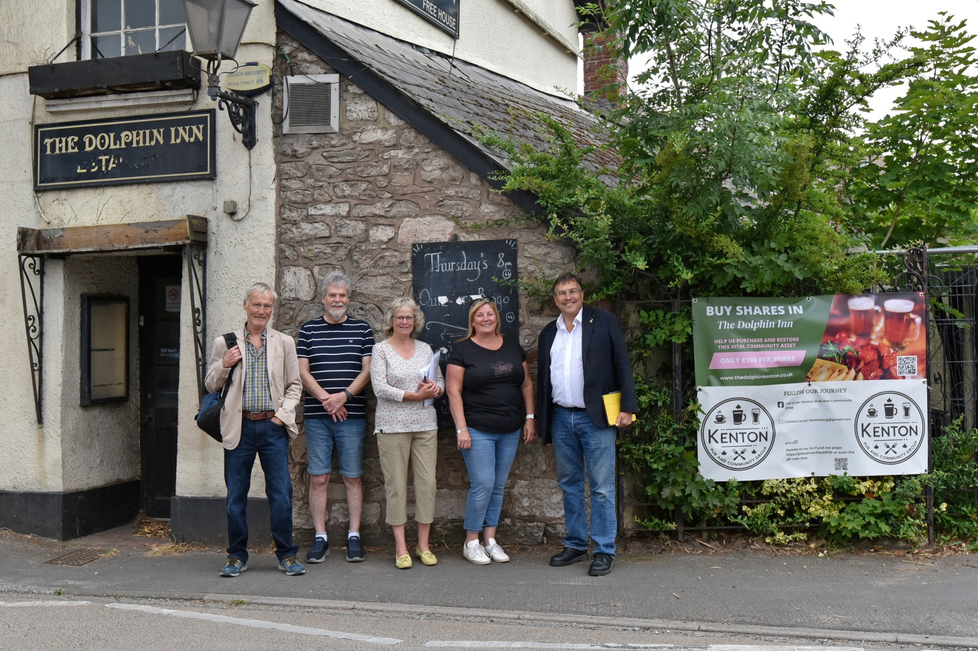
MARTIN WRIGLEY & GARY TAYLOR
Notes:
Saturday 5th July.
Martin and Gary both extremely positive about our plans, vision and both very keen to help (But unfortunately they don’t have £100,000 in their back pockets!).
Gary is head of Planning at Teignbridge, and has offered us as much help and advice as he can.
Martin offered us a letter of approval, on House of Commons paper, to show that he fully supports us, and this could help us with other funders and just generally improve our standing.

Slide 11
LETTER FROM MARTIN WRIGLEY
Following the meeting on the 5th July

Slide 12

GRANTS
Notes:
We have used the opportunity to discover as many grants as possible, and this is still one we are waiting to hear from.
Our application has gone in to Historic England and we are waiting to hear back from them. £100,000 grant now disappeared.

Slide 13

CORPORATE FUNDING
Notes:
We are looking at alternative funding opportunities, we are not convinced this is the right avenue, but we need to look at it.

Slide 14
SHARE OFFER DOCUMENTS
1500 leaflets printed
Facebook advertising
Radio Devon Interview with Mr Dave Everson!
Personal letters hand delivered
Emails sent to all interested parties
600 dropped through doors by committee
ALSO AVAILABLE ONLINE AND IN HARD COPY

Slide 15
SHARES PLEDGED / PURCHASED
Notes:
Electronic offers Just under 22%,
Hard copies just under 8.5%.
Pledges 2%.
Loan 40%
leaves around 30% unfunded

Slide 16
At the moment, we don’t have enough
We have had many shares which is fantastic, however, we need significantly more to secure The Dolphin Inn
If 50 people TONIGHT gave £100 £5,000
If 50 people TONIGHT gave £200 £10,000
If 30 people TONIGHT gave £500 £15,000
If 20 people TONIGHT gave £1000 £20,000
WE COULD HAVE RAISED OVER 50 % !!

Slide 17
PLEASE HELP US – NOW!
Notes:
Current 32%
50 more at £100 = £5,000
50 more at £200 = £10,000
30 more at £500 = £15,000
20 more at £1000 = £20,000
Another £50,000 – would be £130,000
Plus a Loan at 40% would leave us under 10% unfunded.

Slide 18
WHAT’S NEXT!?
We need to offer, under the community order, by tomorrow (30th July)
Meeting arranged with the current owner
Should the offer not be accepted, the owner has the right to market
Notes:
We will carry on raising money.
We will not give up.

Slide 19
PLANS: B, C & D!!
WE HAVE LOTS OF THOUGHTS, LOTS OF IDEAS, LOTS OF ENTHUSIASM TO PUT TO THE OWNER TOMORROW.
WE WILL BE ASKING THEM FOR A BIT MORE TIME
WE WILL BE ASKING YOU FOR MORE MONEY
WE WILL UPDATE YOU WITH MORE INFORMATION FOLLOWING OUR MEETING WITH THE OWNER.
Notes:
Share offer window will be extended.

Slide 20

OTHER COMMUNITIES HAVE DONE THIS - IT DOES WORK!
The Stoke Cannon Inn
The Drew Arms, Drewsteignton.
The Sir Walter Raleigh, East Budleigh
Paradiso, Bovey Tracey
The Tally Ho, Littlehempston
Cadeleigh Arms, Cadeleigh
The Kings Arms, Strete
The Royal Oak, Meavy
Five Bells, Clyst Hydon
Notes:
All of these communities have done it. Many did it taking in to account 18 months/3 years to raise these funds.

Slide 21
WHAT CAN YOU DO NOW?
PLEASE FILL IN A SHARE OFFER FORM TONIGHT.
01
FILL IN A SHARE OFFER ONLINE WHEN YOU GET HOME.
02
ASK US TO FILL IN YOUR FORM FOR YOU.
03
YOU MAY BE THE ONE WHO MAKES OR BREAKS THE DEAL!
Notes:
You can do 2 or more!!!

Slide 22


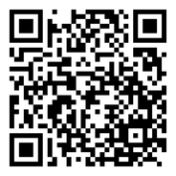
WE CAN DO IT
THANK YOU FOR BEING HERE
THANK YOU FOR CARING ABOUT YOUR VILLAGE
THANK YOU FOR YOUR VISUAL AND VERBAL SUPPORT
THANK YOU FOR YOUR SHARE OFFERS, REGARDLESS OF HOW BIG OR SMALL.
SCAN TO BUY SHARES

Slide 23
Any Questions? Please find a member of the committee who will be delighted to help.

